Slide 1
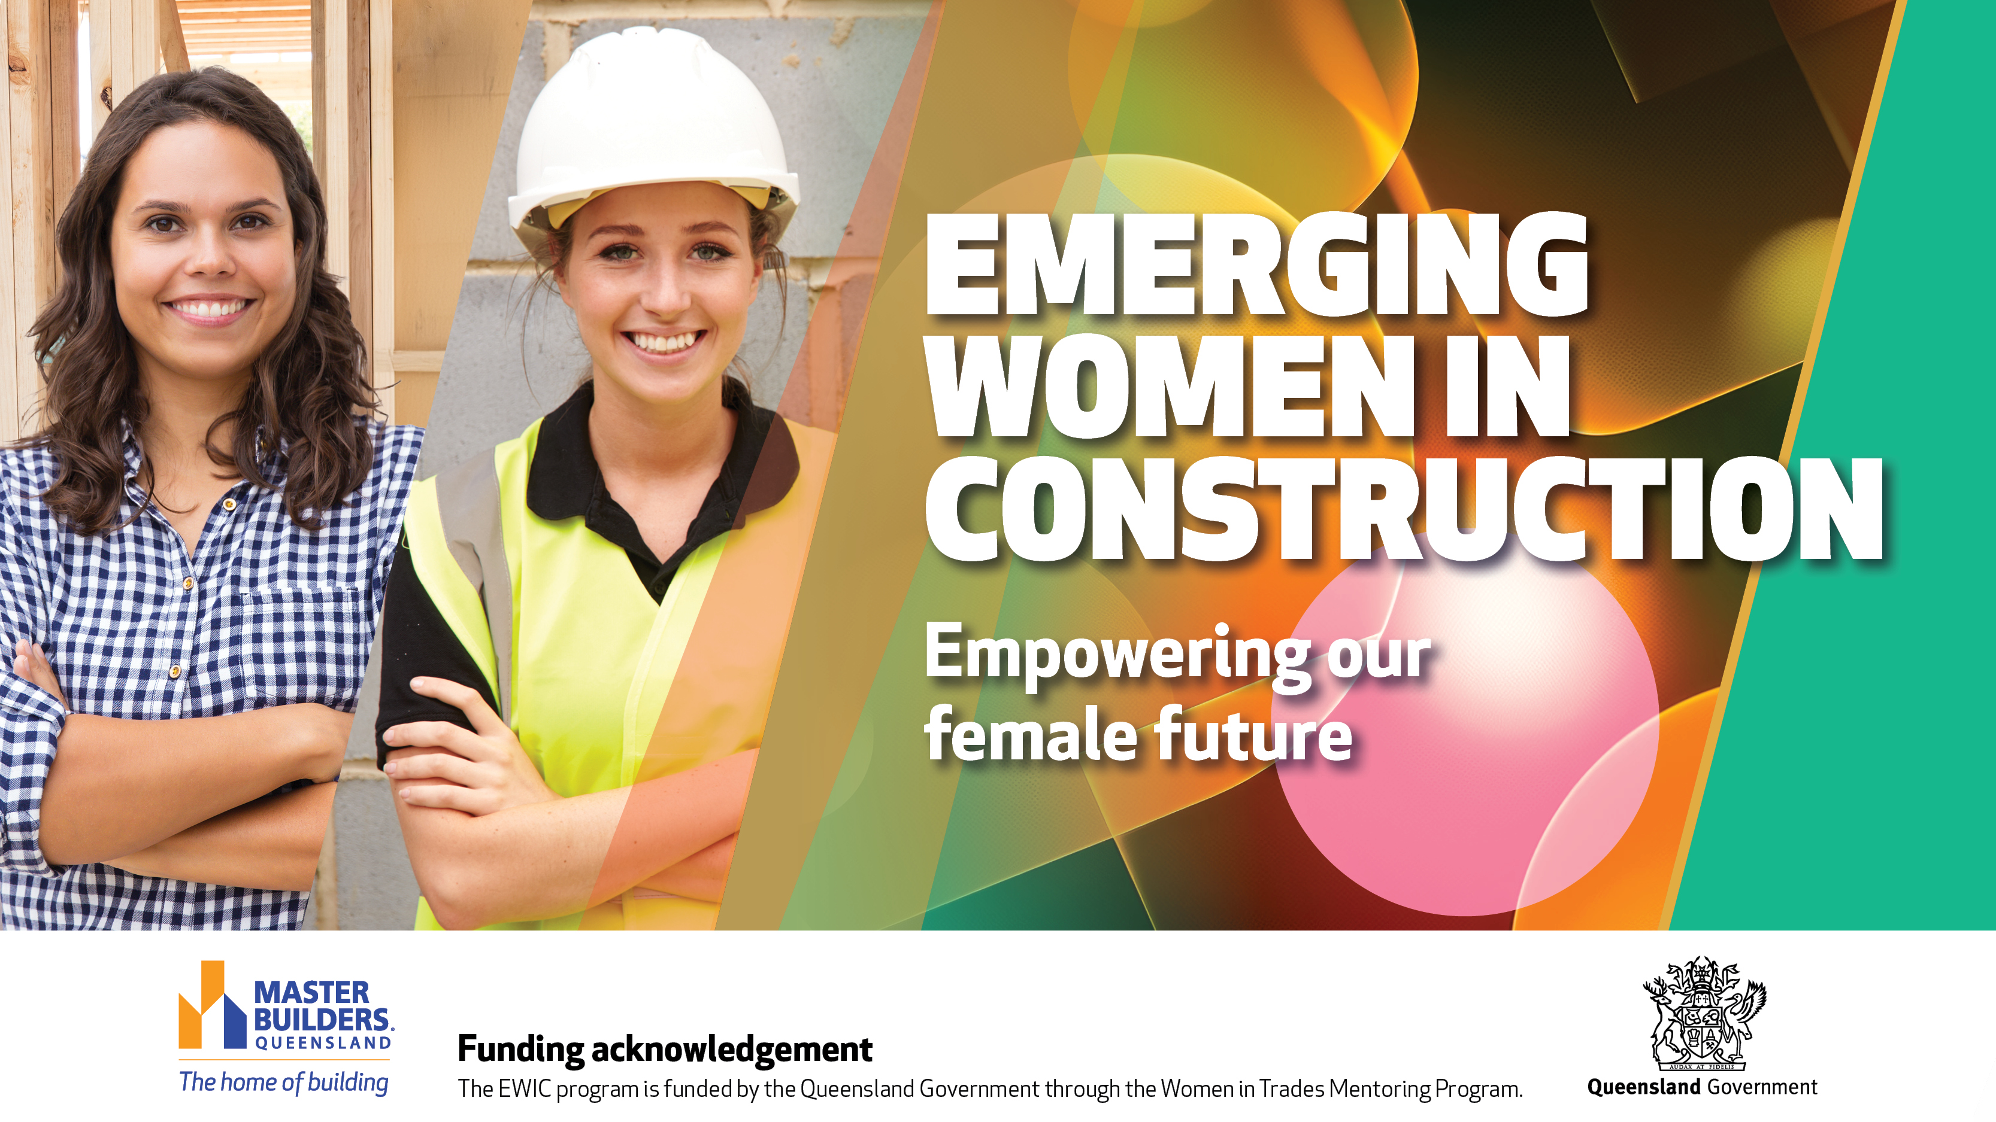
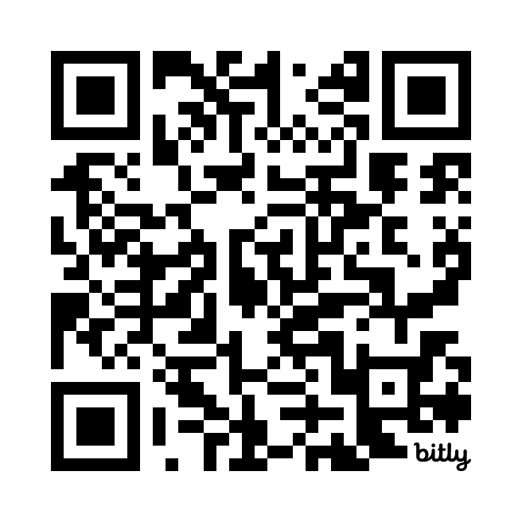
WEBSITE
Notes:
The Master Builders Empowering Women in Construction (EWIC) program provides female apprentices in Queensland’s building and construction industry access to support and advice from experienced industry mentors and advisors with goal to supporting women and their careers in the industry.
The program includes a mentoring program that will team-up industry-experienced professionals with industry apprentices.
It also provides our participating program apprentices and mentors with practical support and advice from our dedicated helpline with our employment & wages advisors on hand to answer their questions; as well as regular webinars, training and events, and plenty of information to support them. Program mentors & apprentices can also join our dedicated Facebook chat group to connect with other female apprentices from across Queensland.
Who can join?
Female building and construction industry apprentices in Queensland.
Apprentices can apply to be a part of the program whether they work for a Master Builders member or not.
Who can mentor?
We're keen to connect female apprentices with experienced women in the industry, but anyone with a passion for supporting apprentices who has experience and knowledge to share is welcome.
Use the QR code on the screen to jump straight to our website page for more info or chat to one of our team members today!

